Slide 1
AI Implementer: New Horizons
HL VAN ZYL 17640296

Slide 2
Introduction
This presentation aims to show you that our AI implementer consistently outperforms the benchmark strategy as well as the median performance of our peers and that is before taking fees into account.

Slide 3
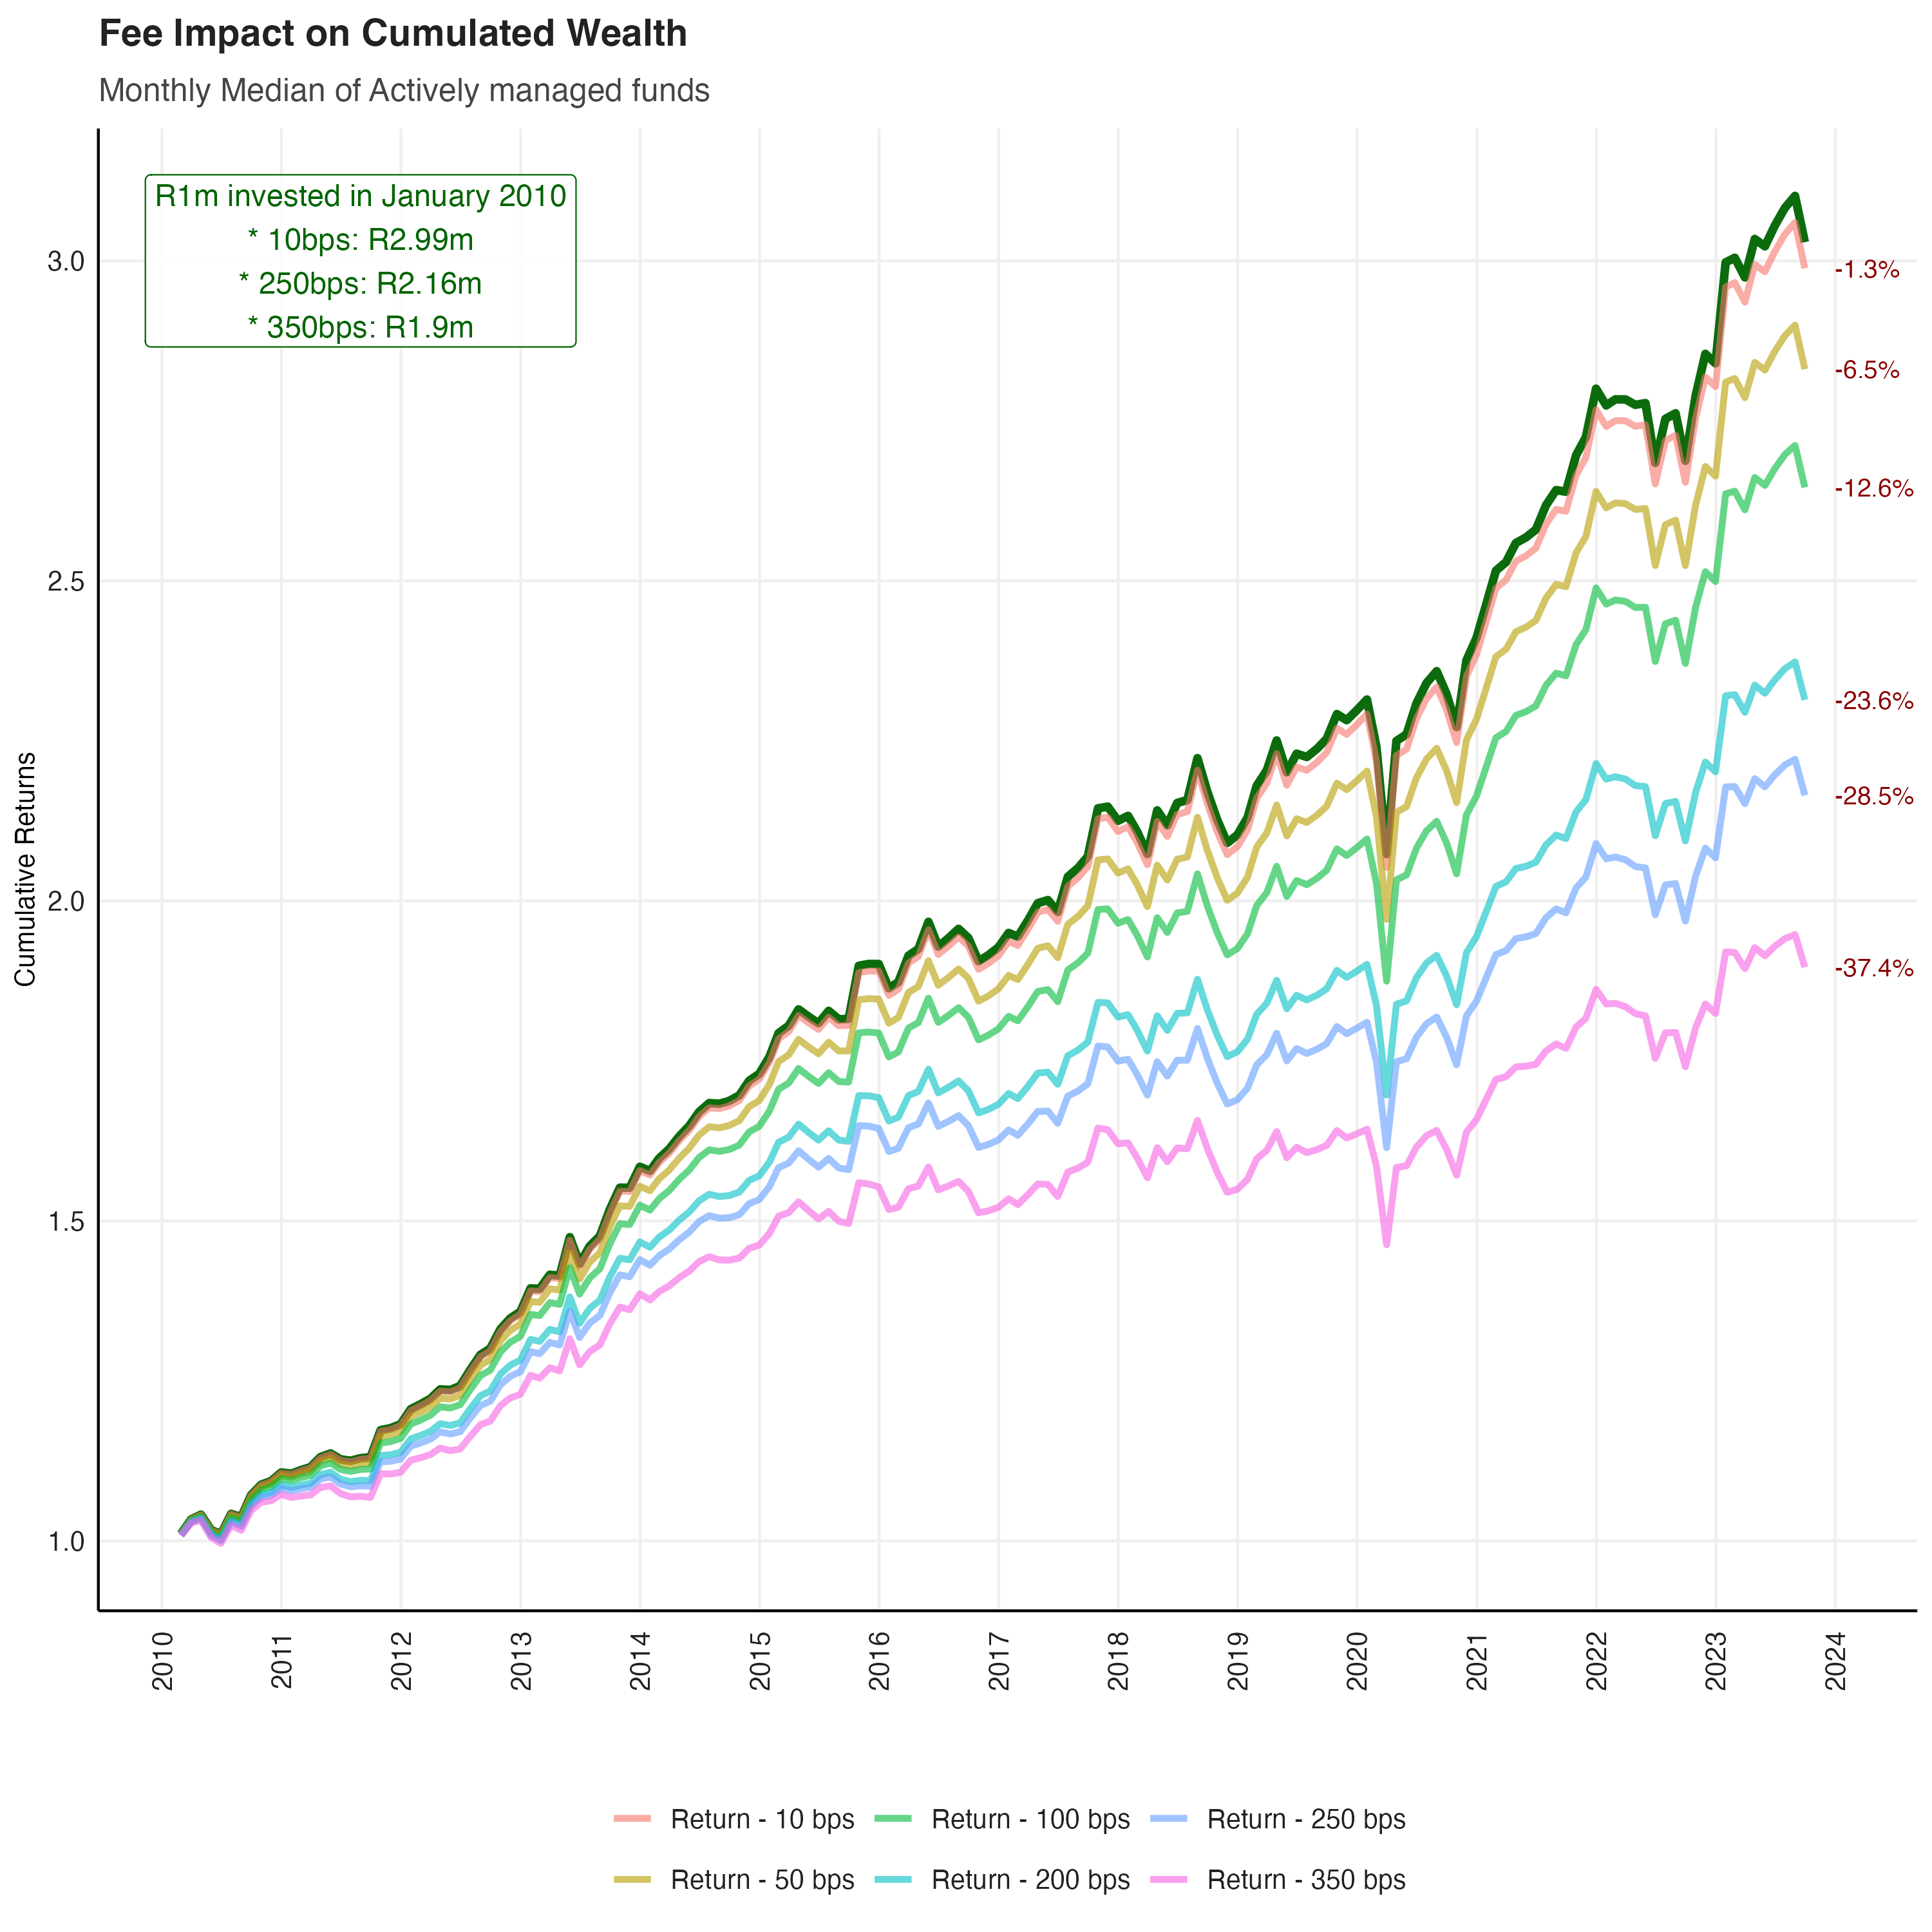
Tyranny of fees
First let’s demonstrate the destructive impact of fees on your long run cumulative returns

Slide 4
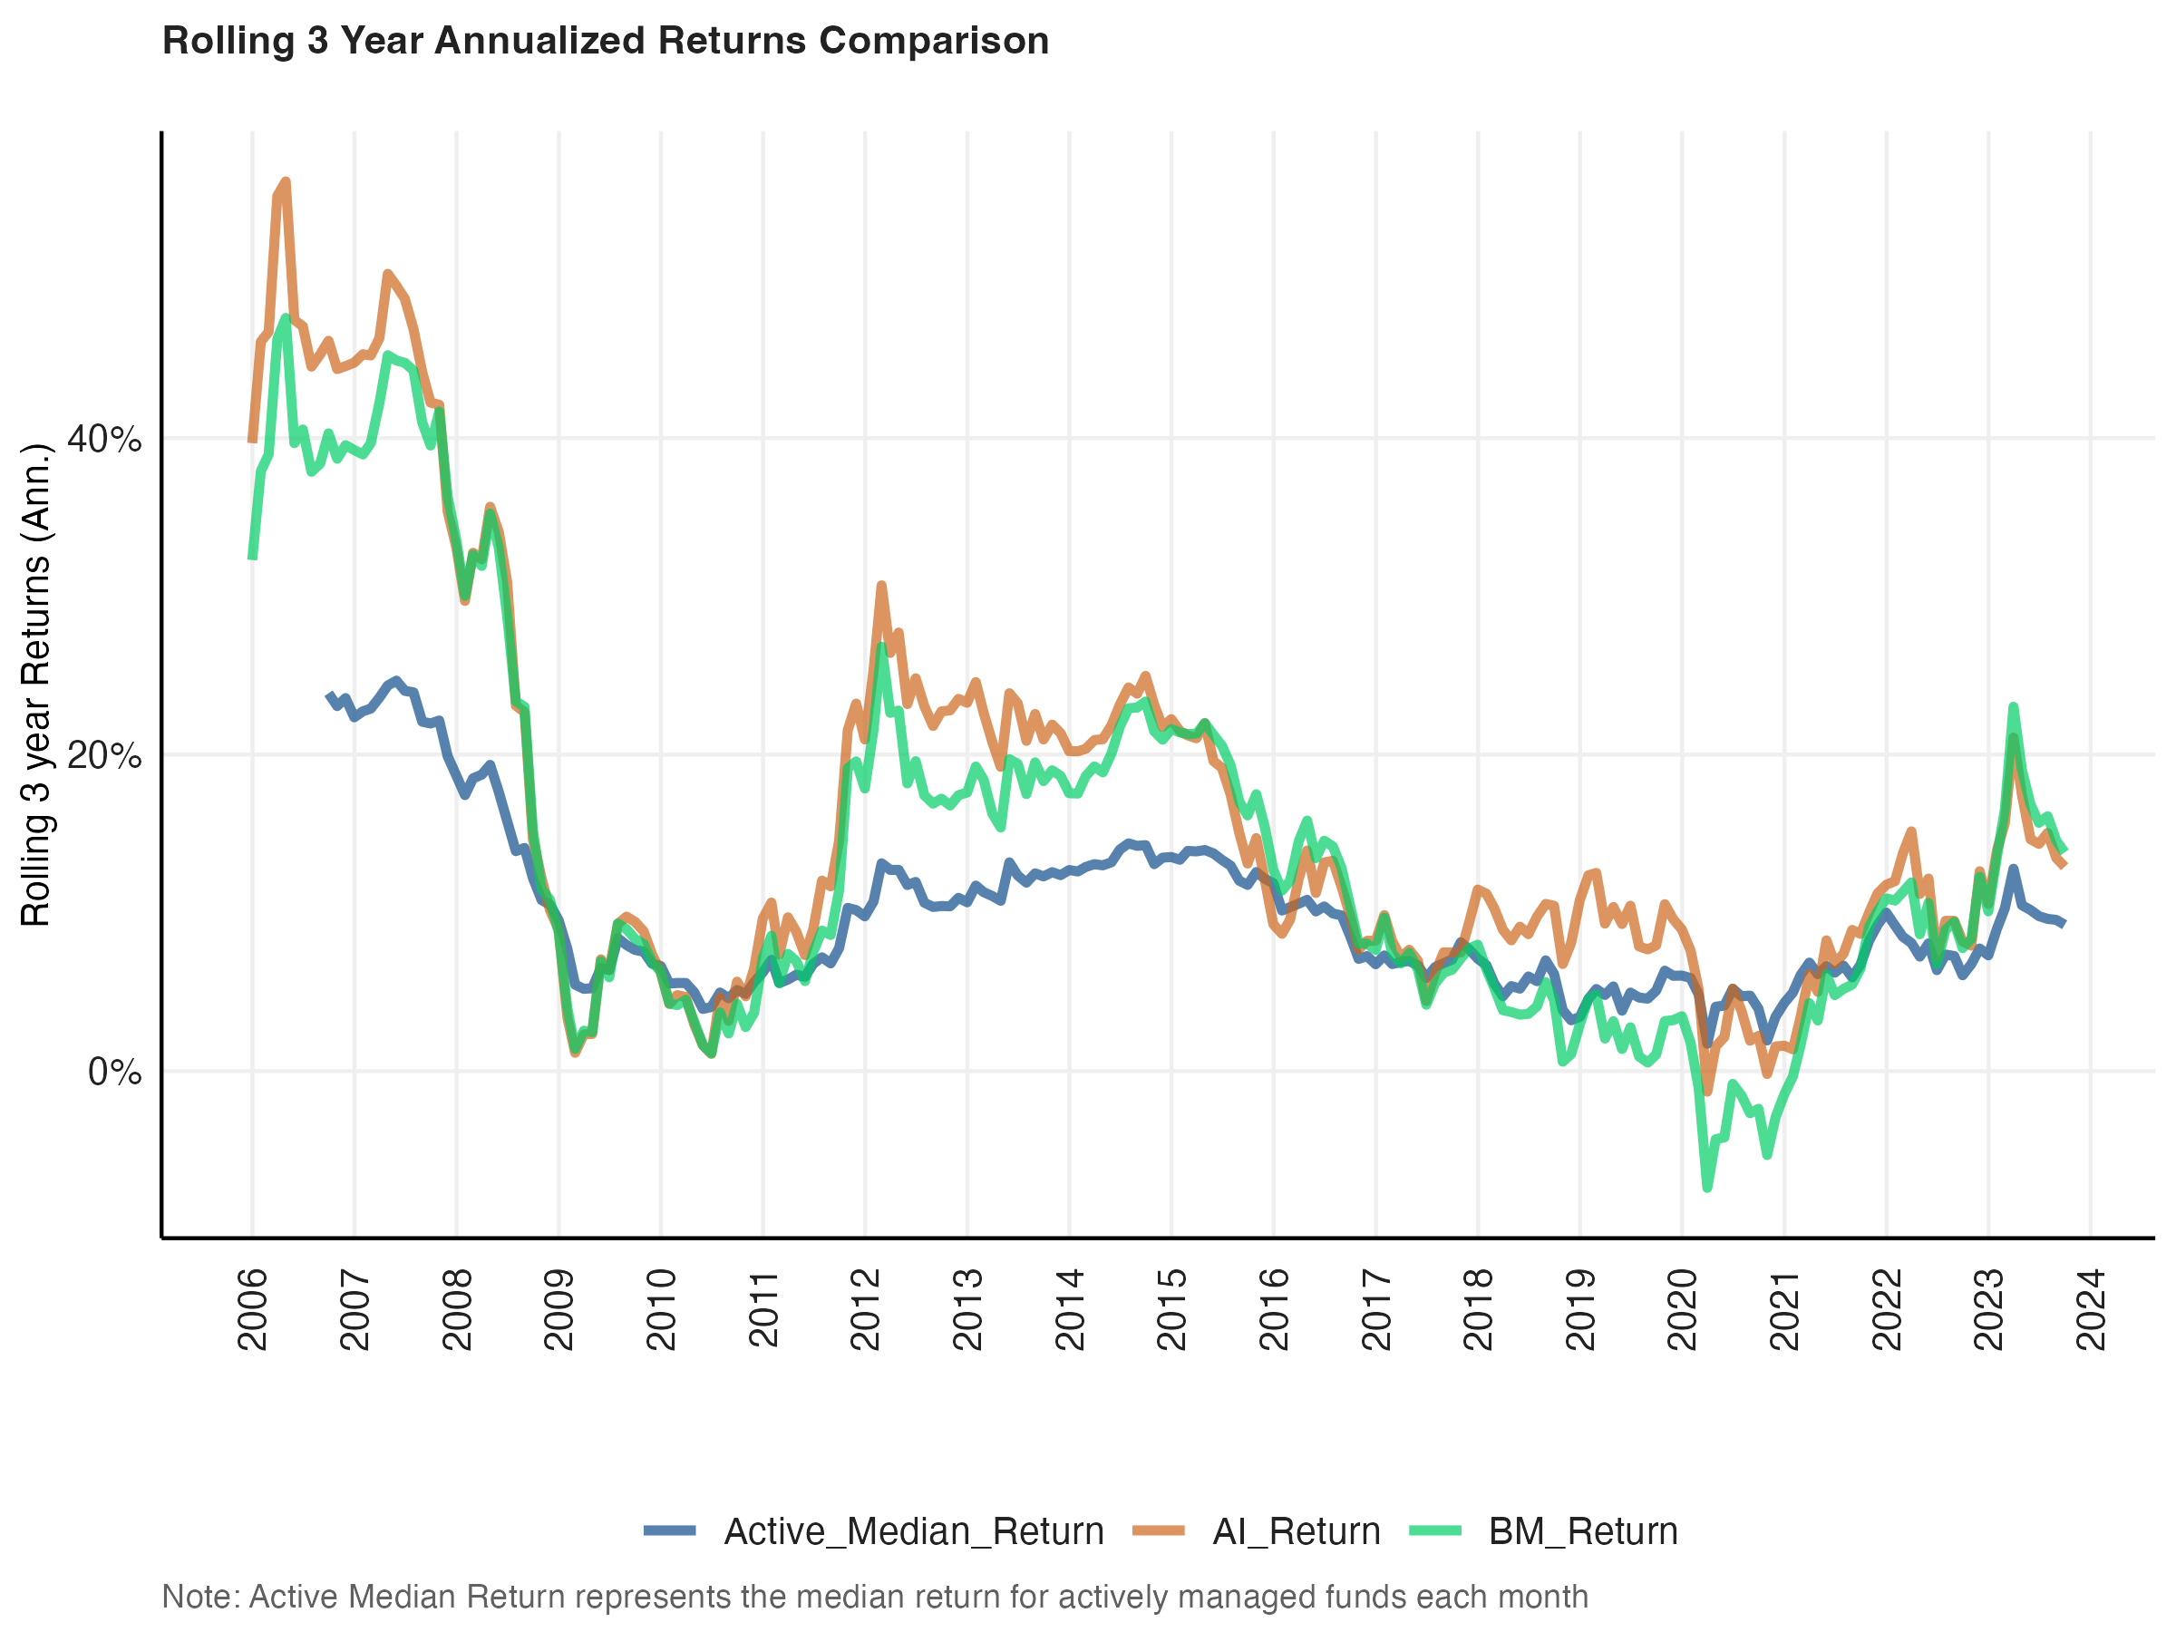
Rolling Returns
Our fund consistently far outperforms the median actively managed funds BEFORE taking management fees into account
It is also consistently outperforms the benchmark strategy

Slide 5
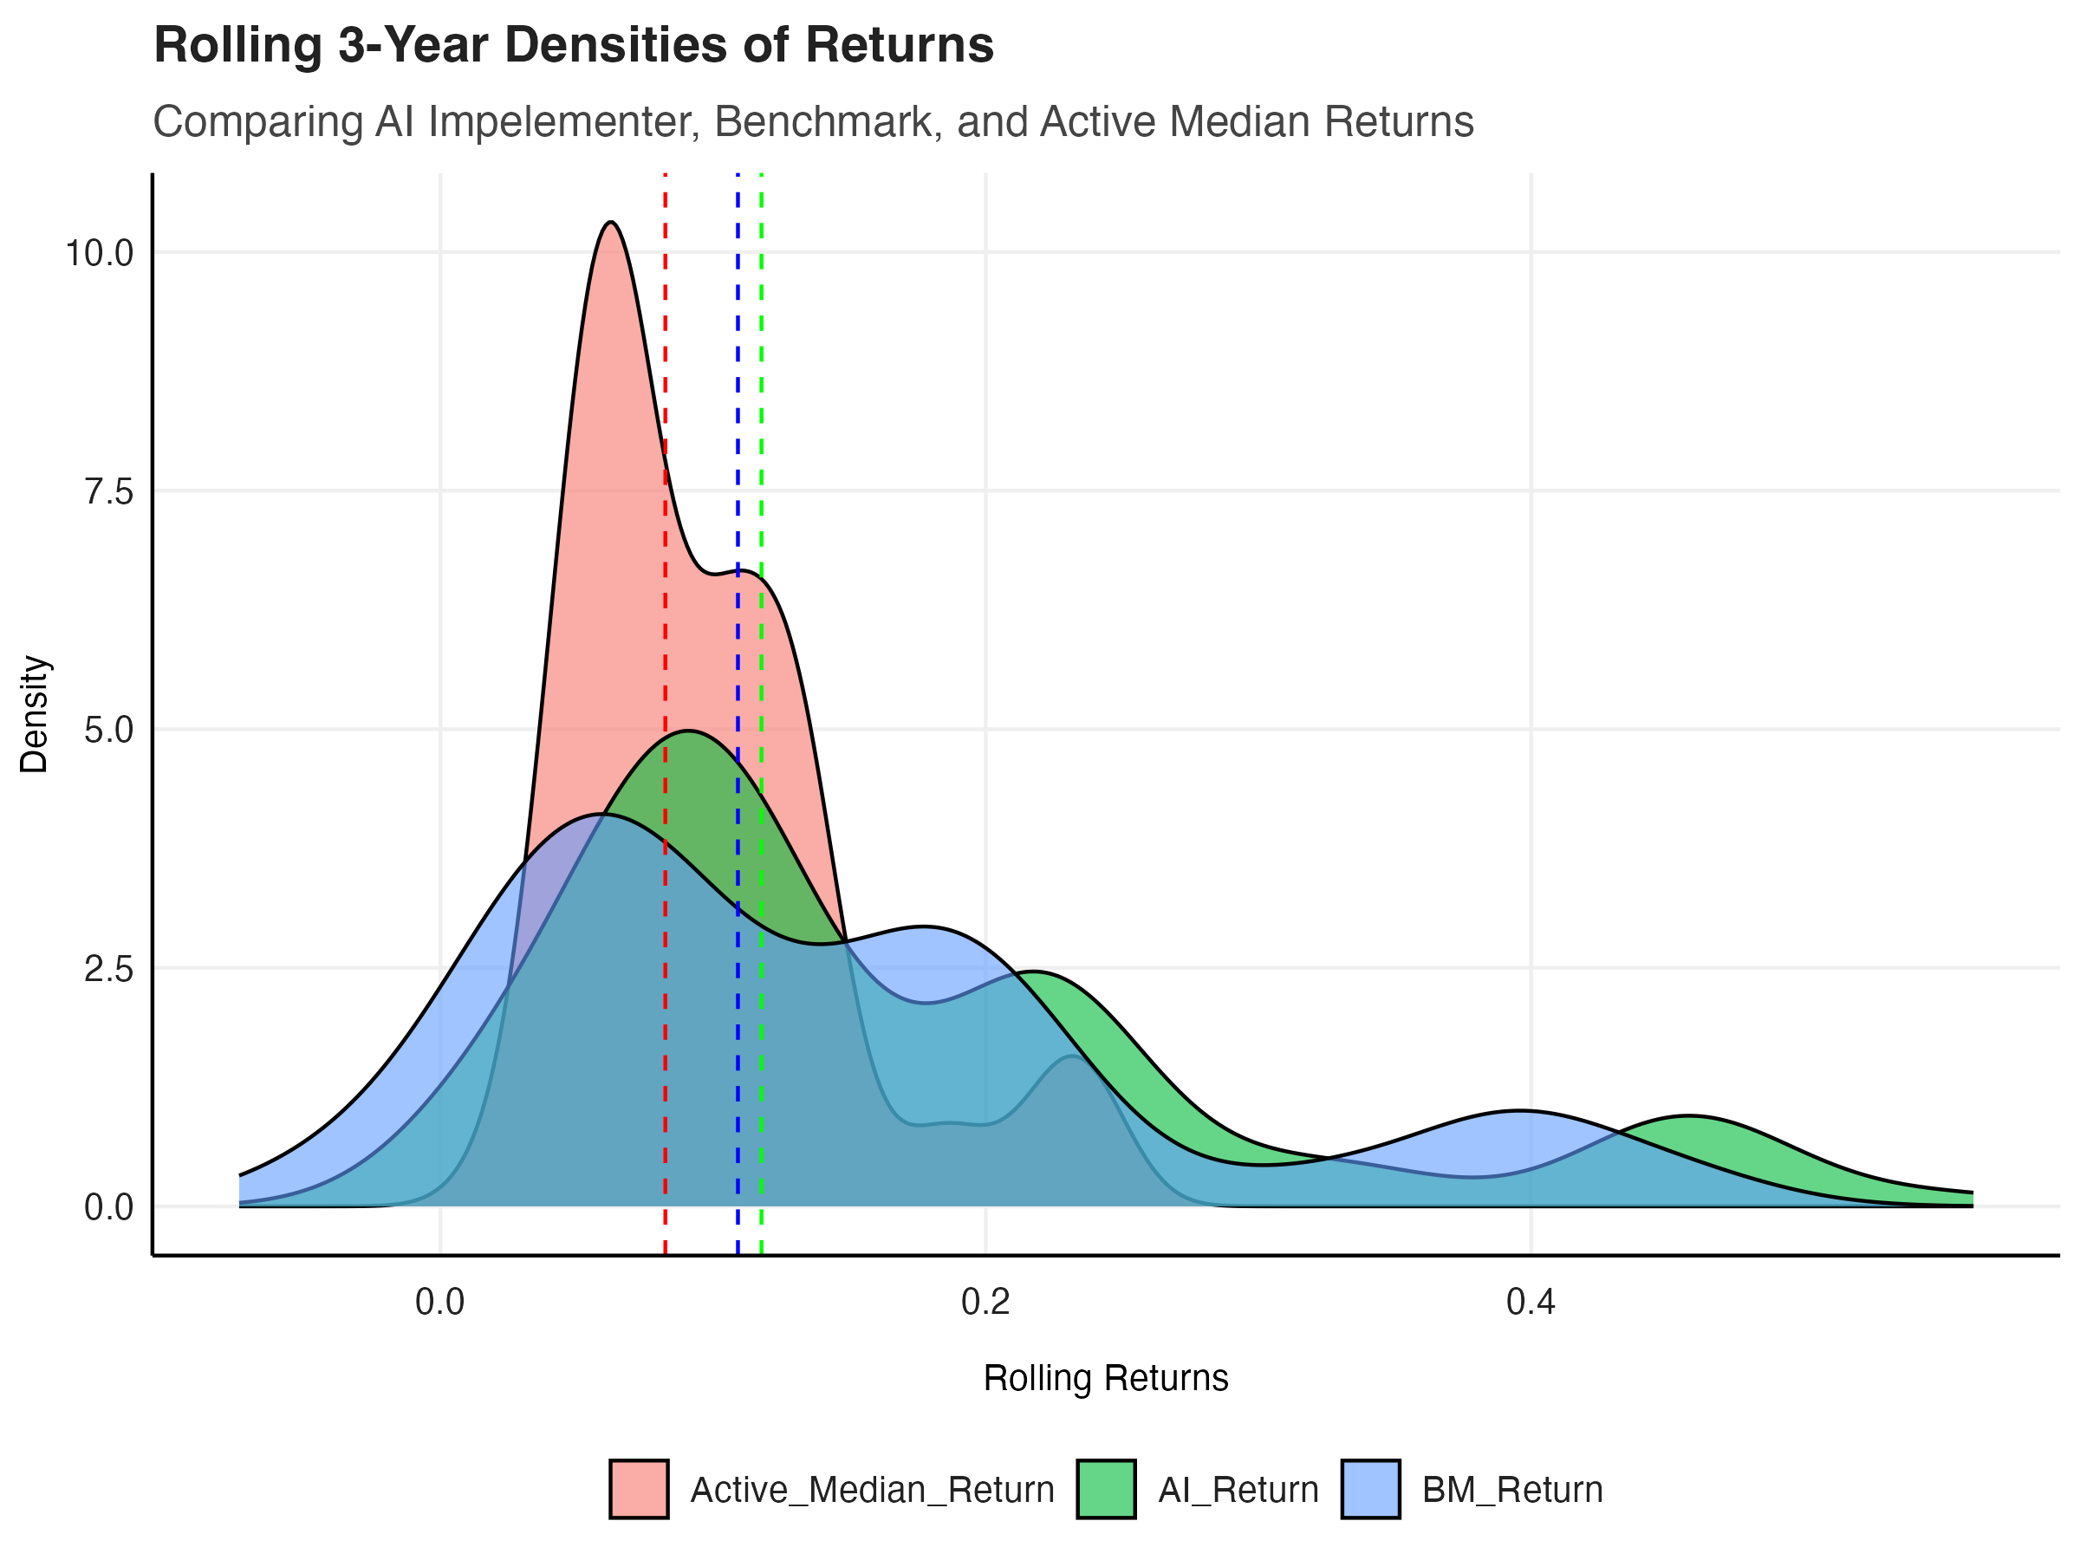
Rolling Densities
Here we can clearly see the median return of the AI implementer beats the benchmark and Actively managed funds

Slide 6
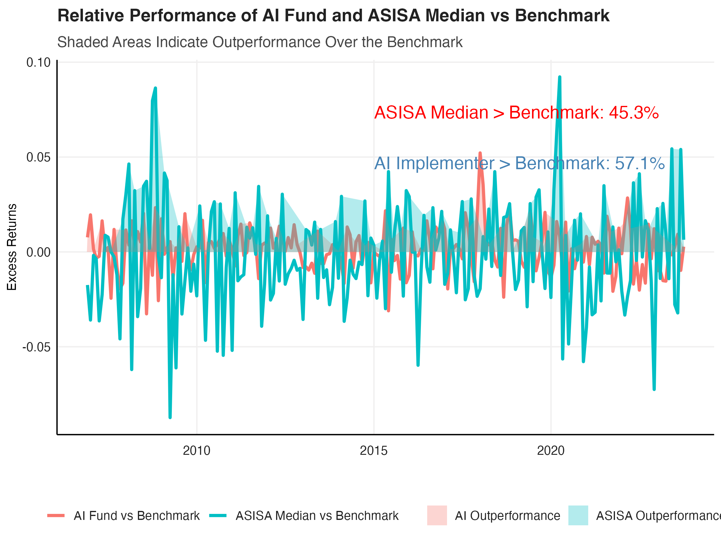
Performance Comparison
This plot shows our AI implementer fund was able to outperform the benchmark in 57% of months
The Median Actively managed fund could only outperform the benchmark in 45% of months

